Slide 1
ECEN 404:
Active Ankle-
Foot Orthosis (AAFO)
Alfred Boss
Christopher Galik
Tyler Pierce

Slide 2
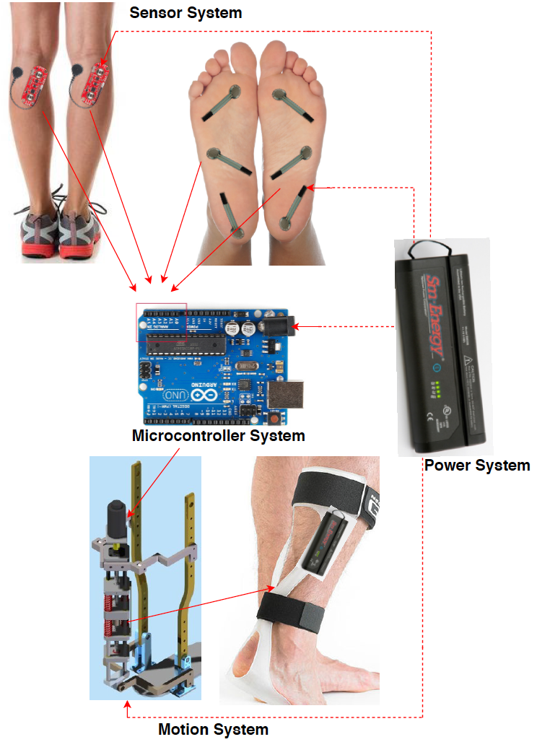
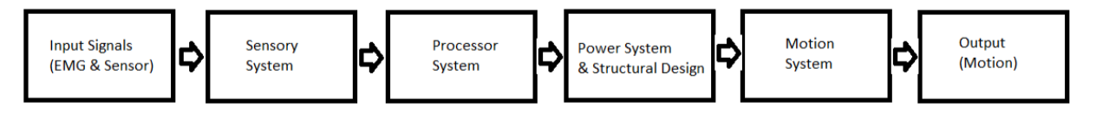
System Overview
EMG sensors and FSR sensors will measure electrical activity and pressure in the leg and foot.
The AAFO will transport signals from the 2 sensors to the MCU.
The microcontroller will interpret signals and determine which stage of gait the user is in and supply corresponding motor control.
The motion system, which acts as an artificial muscle, will move the joint by attaching to a rigid structure.

Slide 3
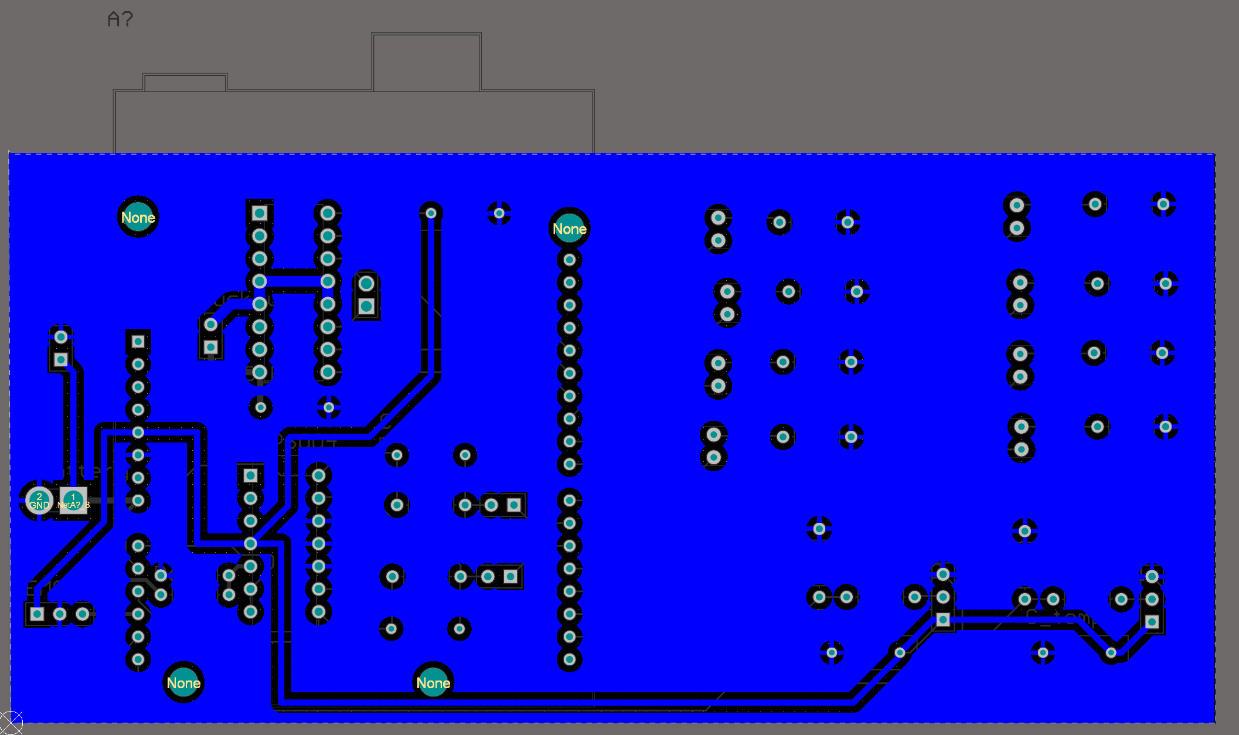
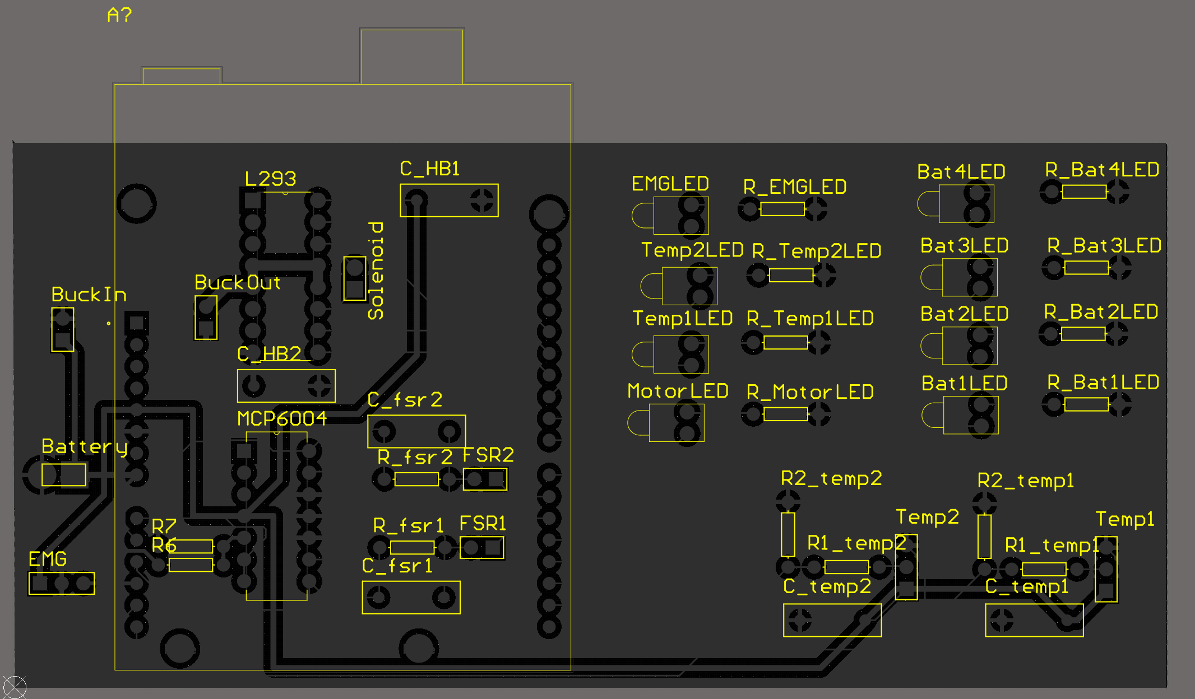
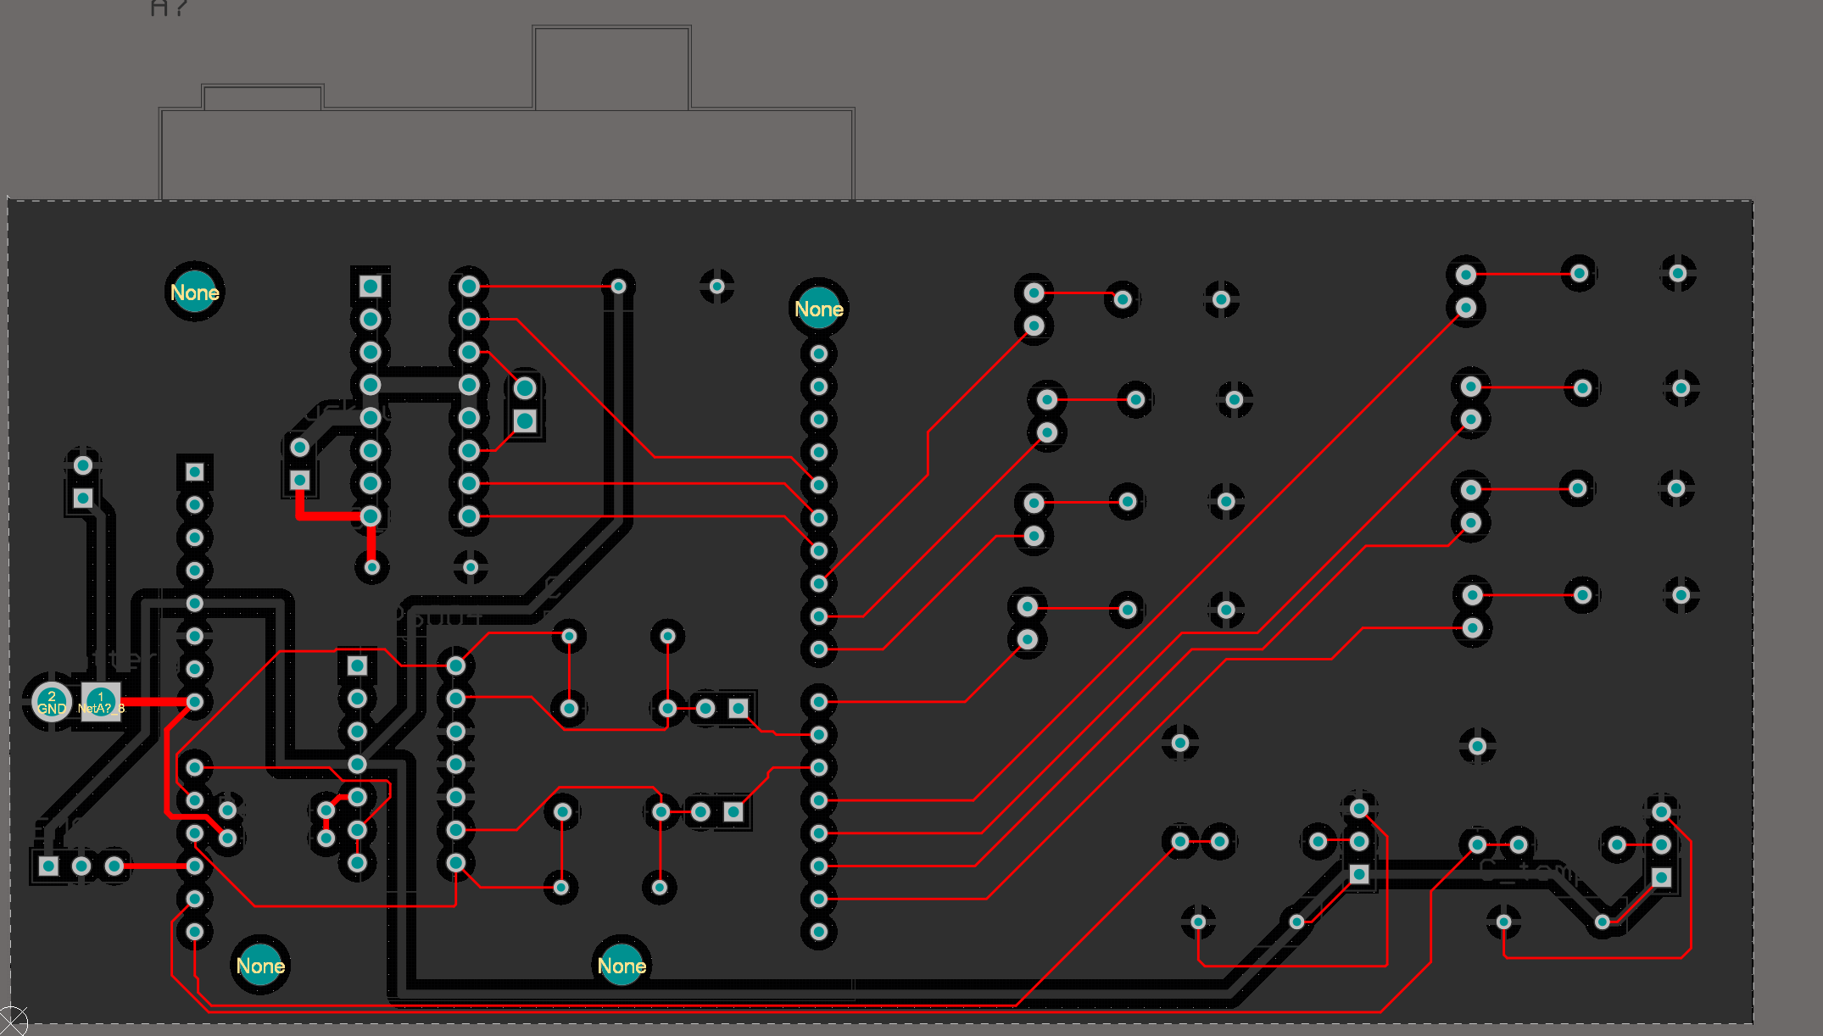
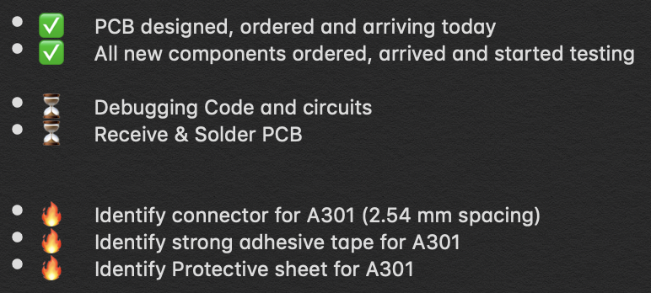
Sensor & MicroController System ~ 60 hours

Slide 4
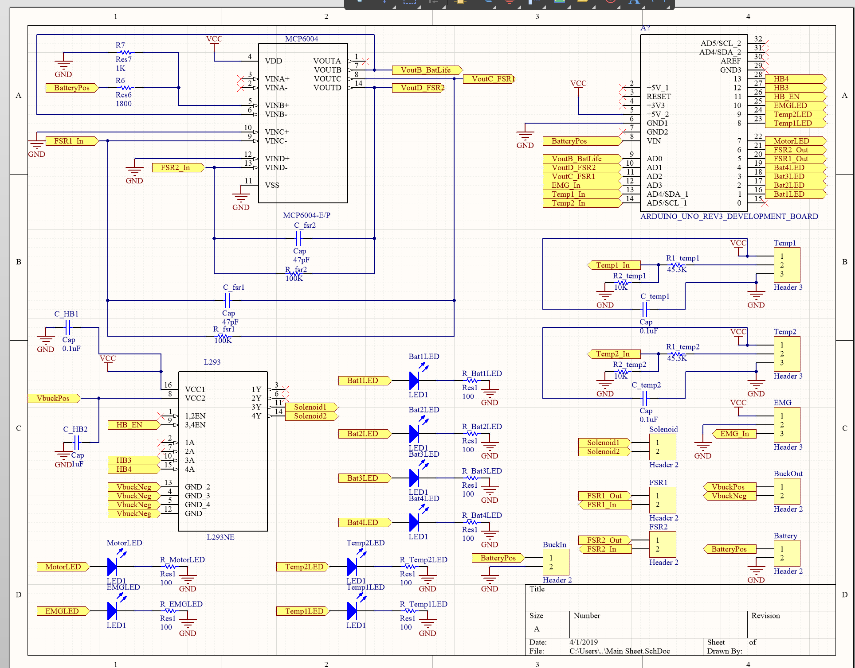

Slide 5
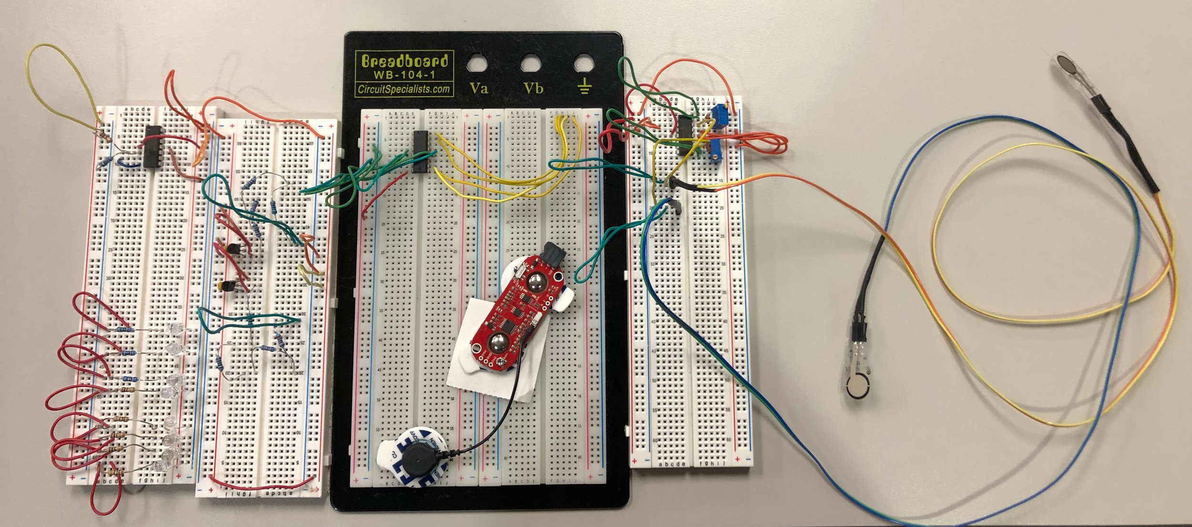
Circuits to go onto PCB

Slide 6
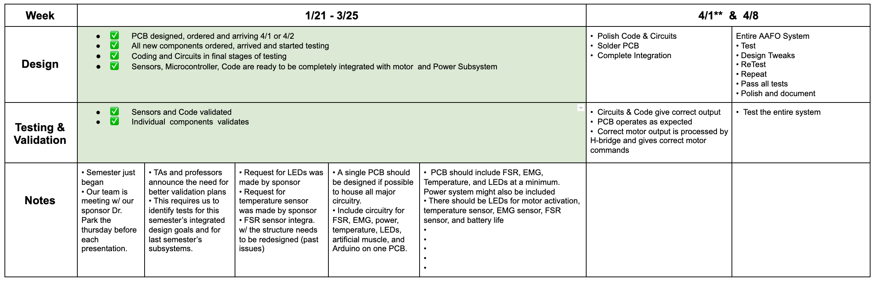
Sensor, Microcontroller, PCB - Execution/Validation Plan

Slide 7
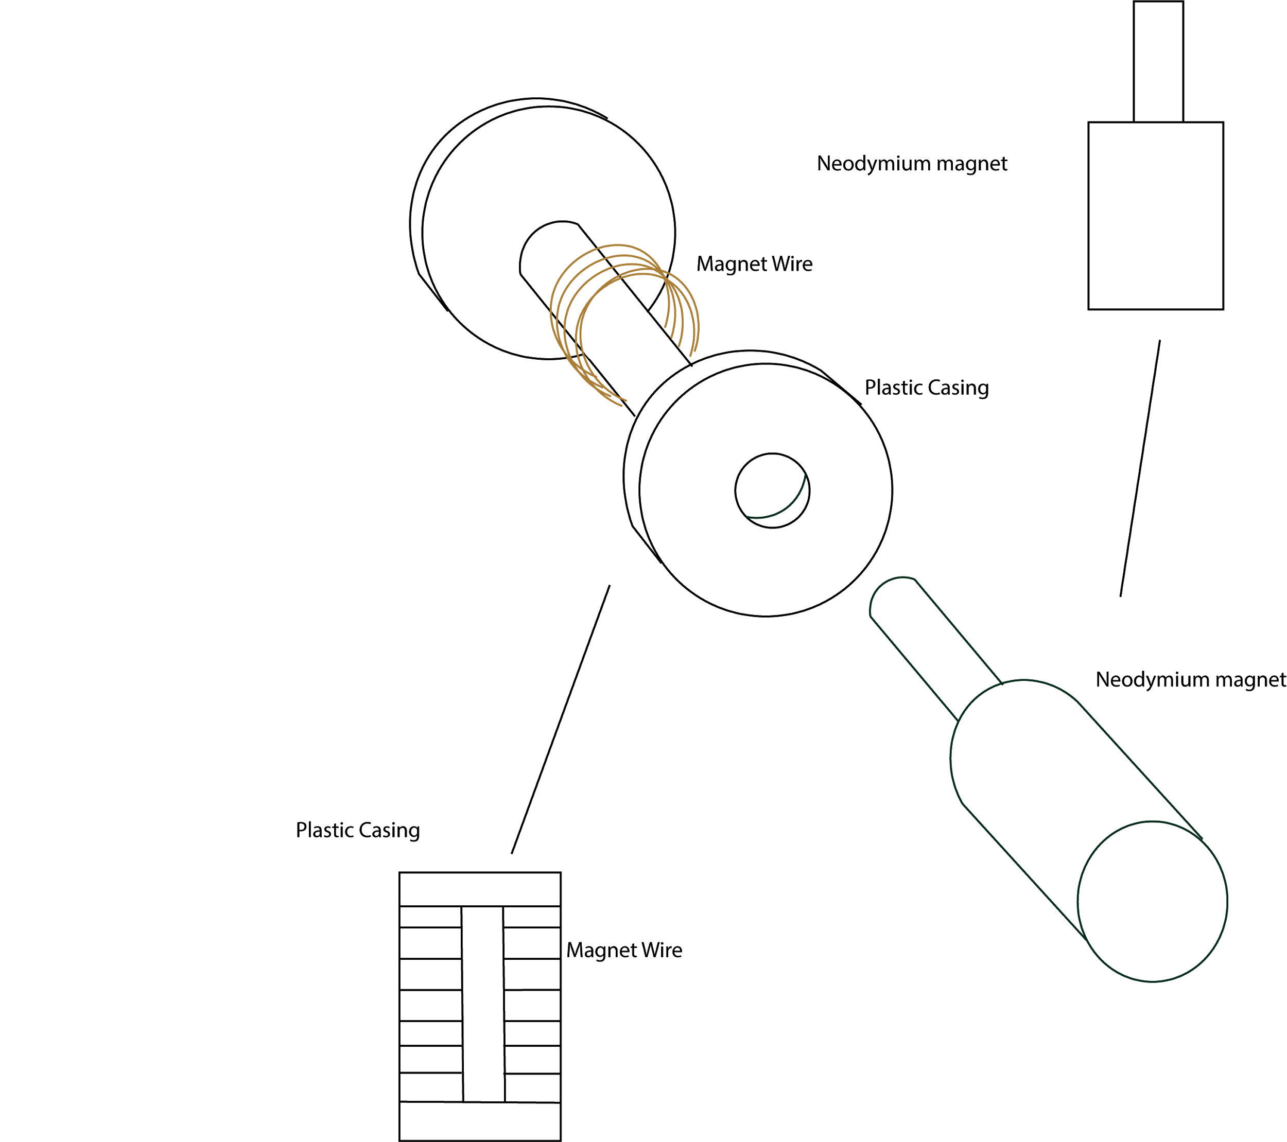
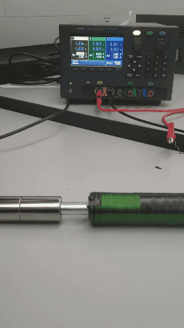
Artificial Muscle/Motion System Development
Bi-Weekly Accomplishments
Functional fabricated components
Ongoing progress/problems
Integration

Slide 8
Structural Design
Updates
No updates
Upcoming
Integrate structure with Artificial Muscle and test

Slide 9
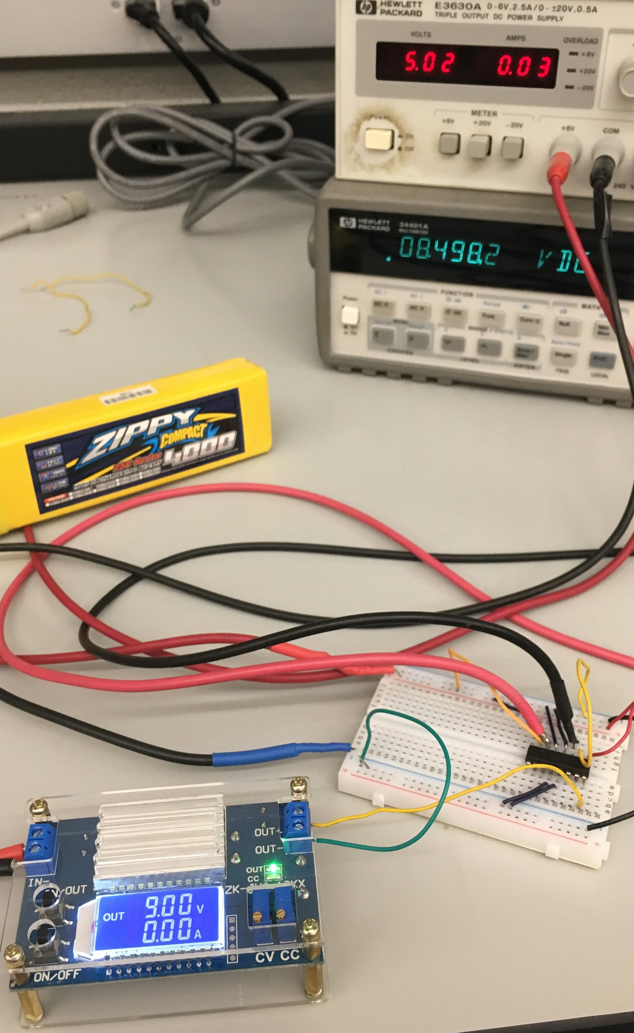
Power System
Updates
Finished Power system validation as stand-alone subsystem
No load condition
No switching problems (blown fuse on multimeter when testing CC)
Upcoming
Integrate with Artificial Muscle and test
Current control - High power rating resistor - LED model, Inductor?
Can force current
Potential custom H-bridge?

Slide 10
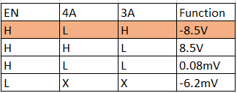
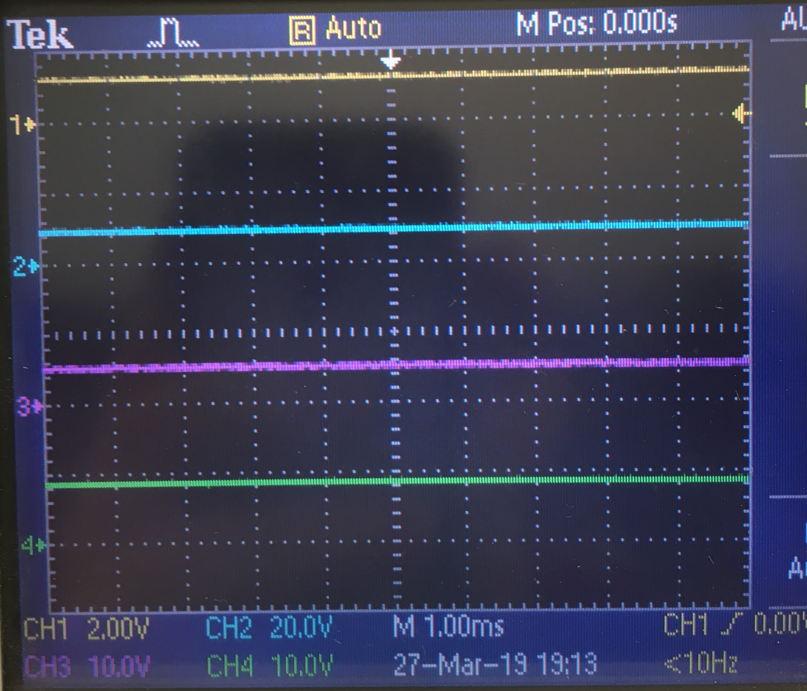
Oscilloscope Validation Function 1 “Extend”
CH1 - Yellow - Battery output
Ch2 - Blue - Converter output
CH3 - Pink - 4A input - High
CH4 - Green - H bridge output - Positive

Slide 11
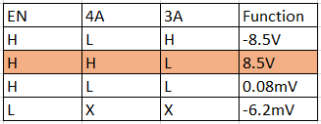
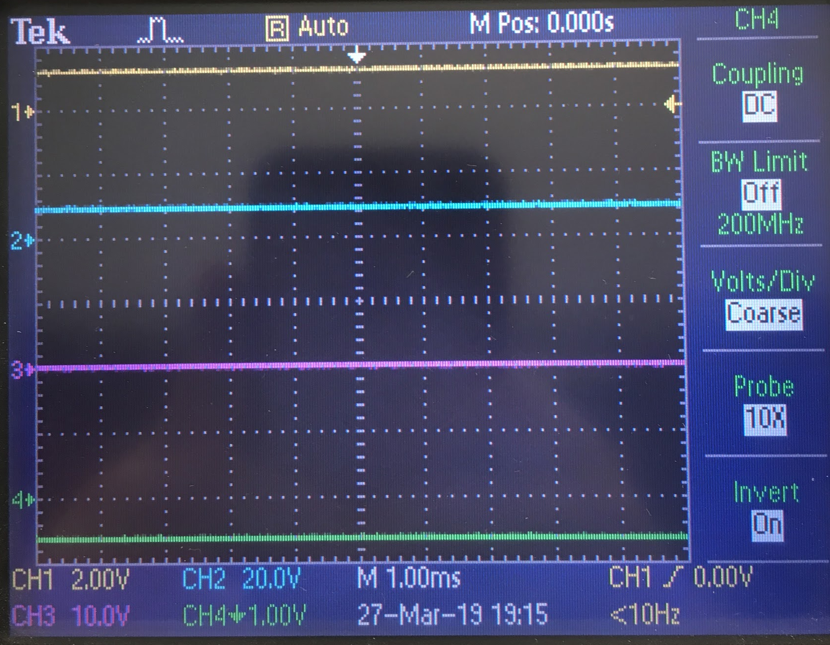
Oscilloscope Validation Function 2 “Retract”
CH1 - Yellow - Battery output
Ch2 - Blue - Converter output
CH3 - Pink - 4A input - Low
CH4 - Green - H bridge output - Negative

Slide 12
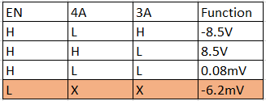
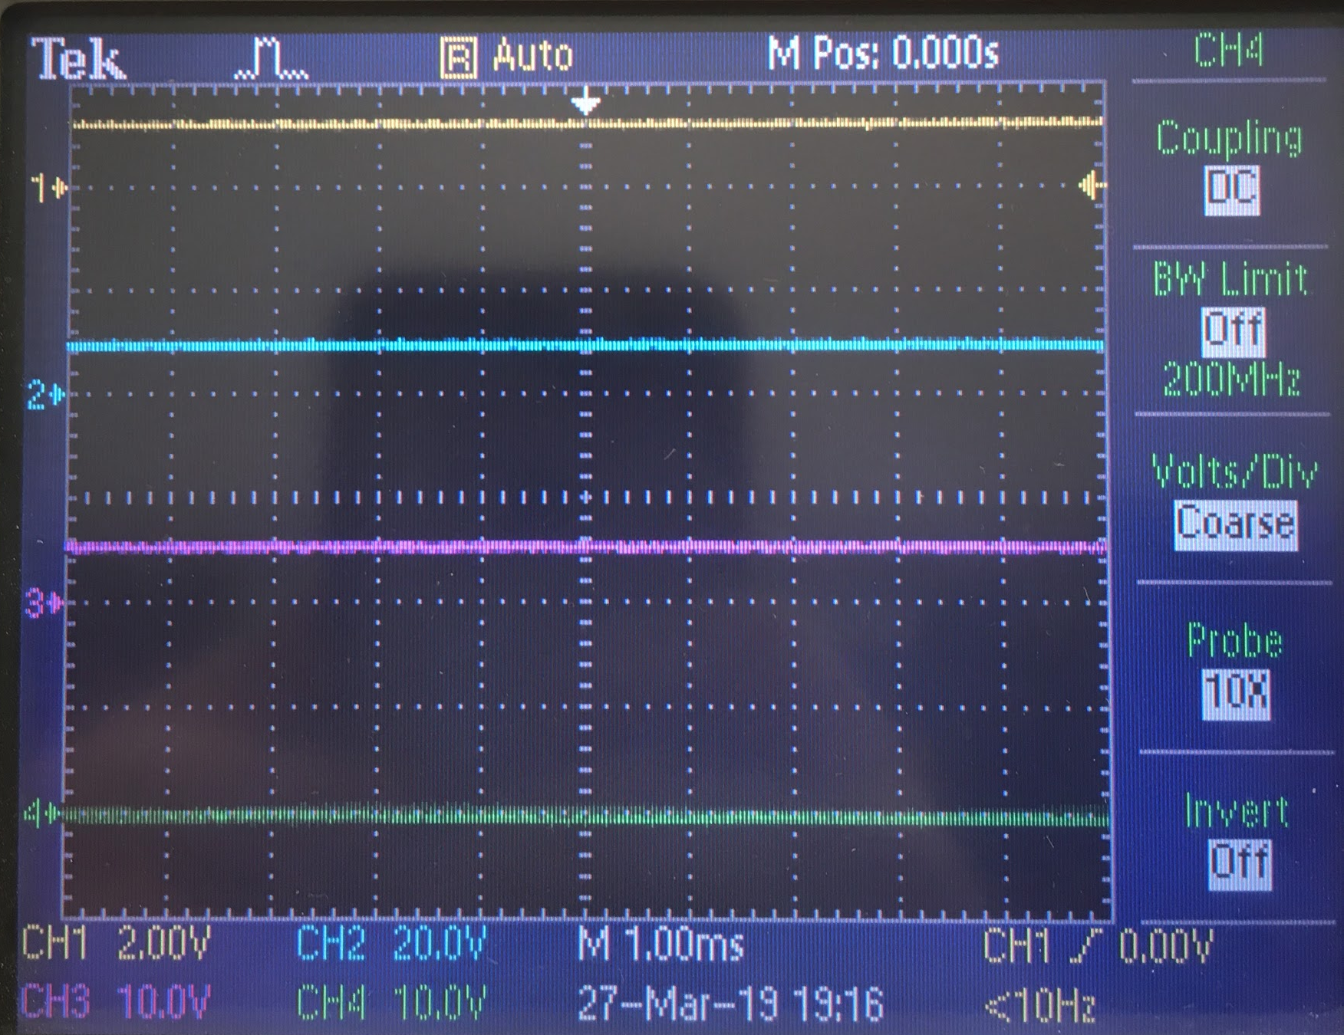
Oscilloscope Validation Function 3 “None”
CH1 - Yellow - Battery output
Ch2 - Blue - Converter output
CH3 - Pink - 4A input - High
CH4 - Green - H bridge output - None

Slide 13
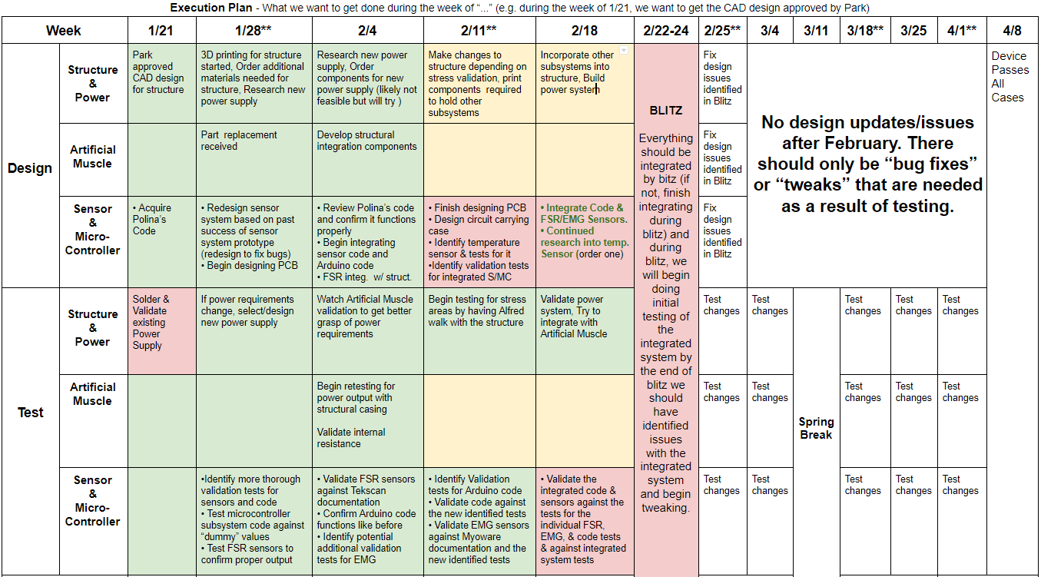
Execution Plan

Slide 14
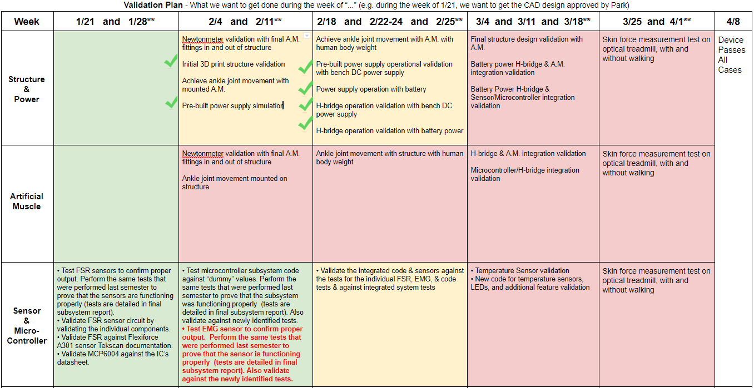
Validation Plan

